Slide 1
DATA STRUCTURE AND ALGORITHMS
Alex Zakas

Slide 2
SWE5002
Assessment Iteration:
For the iteration of this project based on the project requirements there are some key things thing to understand and procced with the program.
The assessment is asking for a class with the attributes of creating a queue with a limit, find the biggest priority target and removing it as well as display the queue at any point of the iteration.

Slide 3

Starting with..
With the begging of the class, we put an input argument to state the size of the list, since is asked on the requirement and create the queue.

Slide 4

Add inside..
For the add priority method, we have an input argument and an if statement that checks if the length of the of the list, exceeds the size the user has putted in.

Slide 5
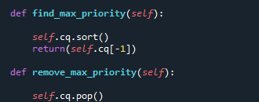
Finding max and removing it..
For finding the biggest number in the queue we took advantage of the “sort” function in python in order to sort the queue from the smallest and pop the last place.

Slide 6
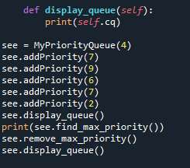

Display and test..
After creating a function for diplaying the list we can now test it with given numbers and steps by the assessment description.

Slide 7



Summary
For the jobs added after the list is full, a message is gonna pop letting the user know there are no more places in queue. And as for the jobs with the same priority LIFO is applied since the sorting function of python is is applied in that way.

Slide 8




Thank you

